Slide 1
SEQUENTIAL LOGIC
In digital circuit theory, sequential logic is a type of logic circuit whose output depends not only on the present value of its input signals but on the past history of its inputs.
This is in contrast to combinational, whose output is a function of only the present input.
That is, sequential logic has state (memory) while combinational logic does not. Or, in other words, sequential logic is “combinational logic with memory”.

Slide 2
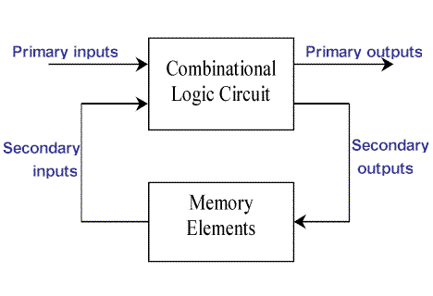
Block Diagram Of Sequential Logic Circuits

Slide 3
Two Main Types of Sequential Circuits
Synchronous types use pulsed or level inputs and a clock input to drive the circuit (with restrictions on pulse width and circuit propagation).
Asynchronous sequential circuits do not use a clock signal as synchronous circuits do. Instead the circuit is driven by the pulses of the inputs.

Slide 4
Flip-Flop
A flip-flop is a binary cell, which can store one bit of information.
A FF is a form of sequential logic gate. In sequential gate, the output state depends on both the inputs and the outputs.
A flip-flop has two states
Set: set state is logic 1 (high)
Reset: reset state is logic 0 ( low)

Slide 5
Flip-Flop
Flip flops are also known as bistable multivibrators, are electronic circuits with two stable outputs one of which is the complement of the other.
The output will change only when directed by an input command.
It has two outputs, one normal and the other its complement.
The state of FF changes only when clock pulse has arrived.
To show the behavior of flopflop we use Characteristics Table.

Slide 6
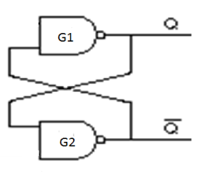
ONE BIT MEMORY CELL OR LATCH
The fundamental flip-flop circuit is shown in figure .it has two NAND inverters G1 and G2. The output of G1 is connected to input of G2 and the output of G2 is connected to input of G1.
Notes:
Cross coupled connection

Slide 7
Let us assume the output of G1 to be Q=1. which is also input of G2. therefore the output of G2 will be Q’=0. which makes the input of G1 to be 0 and consequently Q=1 which confirms our assumption. In a similar way. it can be demonstrated that if Q=0 then Q’=1 this is also consistent with the circuit connection.
From the above discussion we observe that the outputs Q and Q’ are always complementary.
The circuit has 2 stable states and if the circuit is in 1 state. It continues to remain in this state and similarly if it is in 0 state, It continues to remain in this state. Since this information is locked or latched in this circuit. therefore this circuit is also referred to as latch.

Slide 8
Types of Flip Flops
There are different types of FF depending on how their inputs and clock pulses cause the transition between two states. These are:
SR flip-flop
J-K flop-flop
D-flip-flop
T-flip-flop
Master-slave flip-flop

Slide 9
SR FLIP-FLOP
An SR flip flop is the modified version of a latch.
There is no facility to feed the inputs to the latch. To overcome this problem, the inverters are replaced with 2-input NAND gates, the other terminals of the NAND gates can be used to enter the desired digital information.

Slide 10
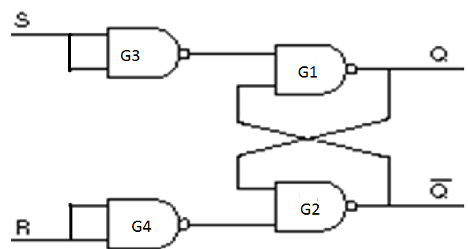
SR Flip Flop –Truth Table *
S | R | Q | STATUS
0 | 0 | PREVIOUS VALUE | NO CHANGE
1 | 0 | 1 | SET
0 | 1 | 0 | RESET
1 | 1 | ? | FORBIDDEN

Slide 11
WORKING:-
if S=1 and R=0 the output of G3 will be 0 and output of G4 will be 1 . Since one of the inputs of G1 is 0, its output will be 1. Consequently, both the inputs of G2 will be 1 giving an output Q’=0. hence for this input condition, Q=1 and Q’=0 and is referred to as set state.
Similarly if S=0 and R=1 then the outputs will be Q=0 and Q’=1 and is referred to as reset state.
if the input conditions are changed from S=1, R=0 to S=R=0 or from S=0,R=1 to S=R=0 the output remains unaltered, it holds the previous value.
IF S=R=1 both the outputs Q and Q’ will try to become 1, which is not allowed ,because it is against to the basic assumption, that is Q and Q’ will always be complementary. Therefore this output condition is prohibited.

Slide 12
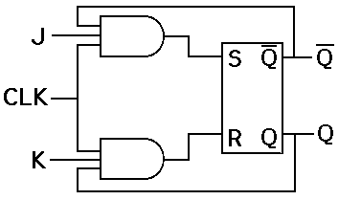
JK FLIP FLOP
The uncertainty in the state of an SR flip flop when S=R=1 can be eliminated by converting it into a JK flip flop.
The data inputs are J and K which are ANDed with Q and Q’ , to obtain S and R inputs .

Slide 13
A JK flip-flop is a refinement of the RS flip-flop in that the indeterminate state of the RS type is defined in the JK type.
Inputs J and K behave like inputs S & R to set and clear the flip-flop.
The input marked J is for SET and the input marked K is for RESET.
When both inputs J and K are equal to 1 , the flip-flop switches to its complement state, that is, if Q=1, it switches to Q=0 and vice versa.
A JK flip-flop constructed with 2 cross coupled NOR gates and 2 AND gates.

Slide 14
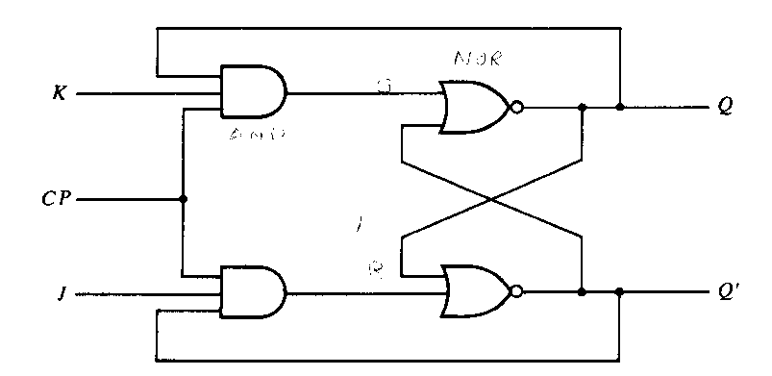
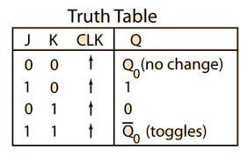
WORKING:-

Slide 15
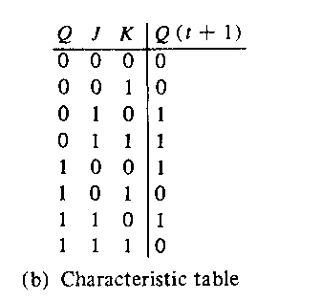
JK Flip-Flop
* JK -- Jack Kilby.

Slide 16
When J=K=0 both AND gates are disabled and Q retains its previous value.
When J=0 and K=1, the upper AND gate is disabled so there is no way to set the flip flop. The only possibility is reset. Therefore when J=0 and K=1 output Q will be 0.
When J=1 and K=0 the lower AND gate is disabled, so there is no way to reset the flip flop. But you can set the flip flop. When Q is low, Q’ is high; therefore the upper AND gate will be enabled and passes the high signal. This drives Q into the high state (set).
When J=K=1, it is possible to set or reset the flip flop. If Q is high the lower AND gate passes the high signal on the next clock pulse. This resets the flip flop. On the other hand, when Q is low the upper AND gate passes a high signal on the next clock pulse. This sets the flip flop either way Q changes to the complement of last state. Therefore J=K=1 means the flip flop will toggle on the next clock pulse.

Slide 17
RACE AROUND CONDITION
The difficulty of both inputs 1 being not allowed in an SR flip flop is eliminated in JK flip flop by using a feedback connection from outputs to the inputs of the AND gates.
We assume that the inputs do not change during the clock pulse, which is not true because of the feedback connections.
consider the inputs are J=K=1 and Q=0 and a clock pulse as shown is applied at the clock input ,after a time interval Δt the output will change to Q=1.
Now we have J=K=1 and Q=1 and after another time interval of Δt the output will change back to Q=0. hence we conclude that for the duration t_{p} of the clock pulse, the output will oscillate back and forth between 0 and 1.
At the end of the clock pulse , the value of Q is uncertain. This situation is referred to as the race around condition .

Slide 18
T(Toggle) Flip-Flop
The T flip-flop is a single input version of the JK flip-flop.
As shown in figure, the T flip-flop is obtained from the JK type if both inputs are tied together. The output of the T flip-flop "toggles" with each clock pulse.
In JK ff , if J=K, the resulting flip flop is referred to as T-type flip flop.

Slide 19


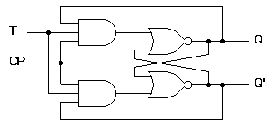
Logic diagram of Clocked T Flip-Flop, symbol, Characteristic Table

Slide 20
The T flip flop has two conditions :
When T=0, the flop flop does a hold. A hold means that the output, Q is kept same as it was before the clock edge.
When T=1, the flip flop does a toggle, which means the output Q is negated after the clock edge, compared to the value before the clock edge.
Thus in a T flip flop, one can either maintain the current state’s value for another cycle, or you can toggle the value (negate it) at the next clock edge.

Slide 21
D Flip-Flop
The D flip-flop captures the value of the D-input at a definite portion of the clock cycle ( such as rising edge of the clock). That captured value becomes the Q output.
At other times, the output Q does not change
The D flip-flop shown in Figure is a modification of the clocked SR flip-flop.
The D input goes directly into the S input and the complement of the D input goes to the R input.
The D input is sampled during the occurrence of a clock pulse. If it is 1, the flip-flop is switched to the set state (unless it was already set). If it is 0, the flip-flop switches to the clear state.

Slide 22
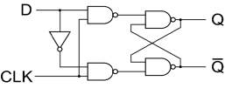
D Flip-Flop *

Slide 23


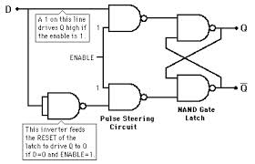
D Flip-Flop

Slide 24
D Flip-Flop
From the truth table it is clear that the output Q at the end of the clock pulse equals the input D.
This is equivalent to saying that “the input data appears at the output at the end of the clock pulse”.
Thus the transfer of data from the input to the output is delayed and hence the name Delay (D) flip flop . The D flip flop is used as a delay device or as a latch to store 1-bit of binary information.

Slide 25
Registers and Shift Registers

Slide 26
Registers
Introduction:
Register is a group of flip-flops with each flip-flop capable of storing one bit of information.
Registers are temporary storage units, made up of integrated circuits (IC’s) of a computer that keep data as well as instructions in binary 0 and 1 form.
Registers are at the top of the memory hierarchy, and provide the fastest way for a CPU to access data.
A register can store as much bits as the number of flip flop it contains.

Slide 27
Simple Registers
No external gates. only FFs(D)
Example: A 4-bit register. A new 4-bit data is loaded every clock cycle.
A₃
A₂
A₁
A₀
Q
Q
Q
Q
D
D
D
D
CP
I₃
I₂
I₁
I₀

Slide 28
Classification of Registers
The register of CPU can be classified as:
1) General Purpose Registers
2) Special Purpose Registers
General Purpose Registers: these registers store data and intermediate results during the execution of a program. They are accessible to user, through instructions if the user are working in assembly language.

Slide 29
1. General-purpose Registers
Some general-purpose registers are as follows:
AX (Accumulator Register): it is used for arithmetic and other data operations. Accumulator is a register in which intermediate arithmetic and logic results are stored.
BX (Base Register): it is used to store memory addresses of data stored in main memory during arithmetic and data movement operations.
CX ( Counter Register): it is used for counting purpose. It acts as a counter for looping.
DX (Data Register): it is used to hold data during division and multiplication operations.

Slide 30
2. Special Purpose Registers:
A CPU contains a number of special purpose registers for different purposes. All CPUs do not contain all of these special registers. These are:
Program Counter (PC): this register deals with the order for execution of instructions. This acts like a pointer that indicates the subsequent memory location where instruction is stored. After one instruction is executed, the PC gets incremented by one to indicate the location of next instruction in serial order.
Stack Pointer (SP): Stack may be defined as a set of memory locations and stack pointer may be defined as the indicator to these memory locations. Stack memory locations are used by microprocessor for storing data temporarily for execution of a program.

Slide 31
3. Status Register: the status register also called Flag register, holds 1-bit flags to indicate certain conditions that arise during arithmetic and logic operations. The important conditions shown by flag or status registers are:
Carry: indicates whether there is overflow or not.
Zero: indicates whether the result is zero or non-zero.
Sign: indicates whether the result is plus or minus.
Parity: indicates whether the result contains odd number of 1s or even number of 1s.
4. Instruction Register: it holds an instruction until it is decoded. That is, it stores the instruction currently being executed.

Slide 32
5. Index Register: index registers are used for addressing. One or more registers are designated as index registers.
6. Memory Address Register (MAR): it holds the address of instruction or data to be fetched from the memory. The CPU transfers the address of the next instruction from the Program Counter to the memory address register. From MAR it is sent to memory through the address bus, sometimes it is called as Address Register(AR).
7. Memory Buffer Register (MBR) or Data Register(DR): it hold the instruction code or data received from or sent to the memory. It is connected to data bus. The data which are written into the memory are held in the register until the write operation is completed. It is also called Data Register (DR). Thus flow of data from CPU to memory or from memory to CPU is always through MBR. It is within the CPU

Slide 33
Shift Registers
Shift registers are direct application of flip flops.
A register capable of shifting its binary information in one or both directions is called shift register.
The shift register is a type of sequential logic circuit that is used for the storage or transfer of data in the form of binary numbers and then “shifts” the data out once every clock cycle, hence the name “shift register”.
Logical configuration of a shift register consist of a chain of flip flops in cascade, with the output of one flip flop connected to the input of the next flip flop.
All flip flop receive common clock pulses that initiate the shift from one stage to the next.

Slide 34
Classification of Shift Registers
Classification based on the mode of input and output:
Serial In Serial Out shift registers (SISO)
Serial In Parallel Out (SIPO)
Parallel In Serial Out (PISO)
Parallel In Parallel Out (PIPO) shift registers.

Slide 35
Serial In/Serial Out Shift Registers
Accepts data serially – one bit at a time – and also produces output serially.
Serial data input
Q₀
Q₁
Q₂
Q₃
Serial data output
D
Q
D
Q
D
Q
D
Q
C
C
C
C
CLK

Slide 36
Serial In/Parallel Out Shift Registers
Accepts data serially.
Outputs of all stages are available simultaneously.
Data input
D
Q
D
Q
D
Q
D
Q
C
C
C
C
CLK
Q₀
Q₁
Q₂
Q₃
Data input
D
SRG 4
Logic symbol
CLK
C
Q₀
Q₁
Q₂
Q₃

Slide 37
Parallel In/Serial Out Shift Registers
Bits are entered simultaneously, but output is serial.
Data in
D₀
D₁
D₂
D₃
SHIFT/LOAD
SRG 4
Serial data out
CLK
C
Logic symbol

Slide 38
Parallel In/Parallel Out Shift Registers
Simultaneous input and output of all data bits.
Parallel data inputs
D₀
D₁
D₂
D₃
D
Q
D
Q
D
Q
D
Q
C
C
C
C
CLK
Q₀
Q₁
Q₂
Q₃
Parallel data outputs

Slide 39
Shift Registers
Basic data movement in shift registers (four bits are used for illustration).
Data in
Data out
Data out
Data in
(a) Serial in/shift right/serial out
(b) Serial in/shift left/serial out
Data in
Data in
Data in
Data out
Data out
(c) Parallel in/serial out
(d) Serial in/parallel out
Data out
(e) Parallel in / parallel out
(f) Rotate right
(g) Rotate left

Slide 40
end of the unit

